Slide 1


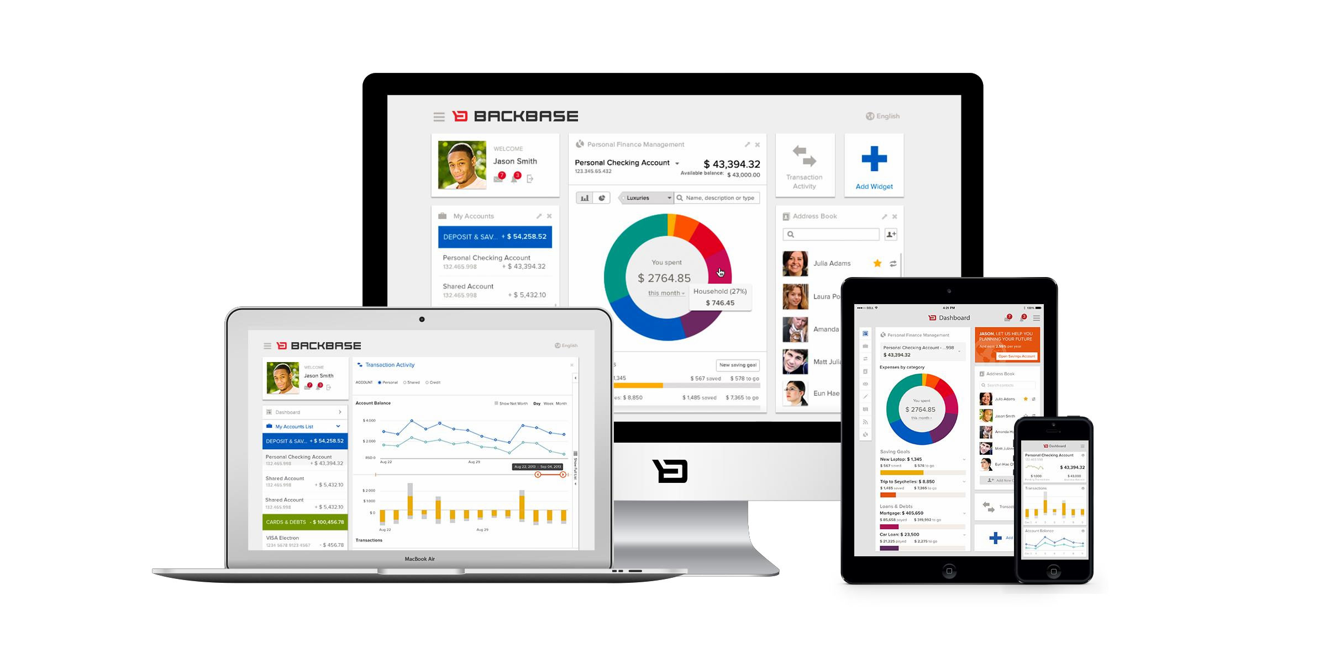
Portal Technologies
Focus Area: Foundation

Slide 2
Training Overview
Group Workshop
Back-end
Front-end
Services Integration
Content Services
Advanced Security
Overview
Widget Development
Template Development
Targeting
Publishing
Portal Client
ICE
Foundation
Portal Essentials
Portal Technologies
Portal Tools
Portal APIs
2

Slide 3
Objectives
Get to know the technologies
Portal is using under the hood
Get to know how to install and run a Portal server in your development environment
Become familiar with the development setup’s directories and files

Slide 4


Languages and Standards
Portal Technologies
4

Slide 5

Portal Skillsets
Node
Bower
LESS
Google Closure
JSP
Twitter
Bootstrap
Spring
CSS
HTML
Java
JSON
Camel
Angular.js
Javascript
XSLT
XML
jQuery
Solr
Require.js
Android
D3.js
Maven
Ant
iOS
Jenkins

Slide 6



Portal Skillsets
Client side developer
BROWSER
GUI Customization
Widgets API
Widgets API
Widgets API
Portal Client API
SERVER
6
Existing Services / Systems / Applications
Personalization Service Integration Service Content Service
ECM / WCM
Biz. Web Services
Portal Services API
Security Service
Single Sign On
ESB / BPM
http / Java
Server
Customization
CRM
Traditional Apps
….
…
Presentation Service
Existing applications developer
Java backend developer

Slide 7

Technologies Overview
Portal Technologies

Slide 8
Portal is an Enterprise Java Application
Java
Makes heavy use of Spring under the hood
Key area’s of Spring
Spring IOC
Spring MVC
Spring Security

Slide 9
Portal client can render the model client side with JS
Javascript
Widget behavior is usually written with JS
jQuery is shipped with Portal as a Portal Client dependency
But not a widget dependency

Slide 10
Very ubiquitous throughout Portal
XML
Most configuration
Web app
Spring
Maven
REST data interchange format

Slide 11
Software tool for software project management and build automation.
Apache MAVEN
Based on the concept of a project object model (POM), Maven can manage a project's build, reporting and documentation from a central piece of information.
Convention over configuration
/src/main/java
/src/main/webapp
/src/test

Slide 12
Archetype is a Maven project templating toolkit
Intro to MAVEN
An original pattern or model from which all other things of the same
kind are made.
Artifacts
An artifact is a file, (usually a JAR), that gets deployed to a Maven repository.
Each artifact has a group ID (usually a reversed domain name, like
com.example.foo), an artifact ID (just a name), and a version string.
A project's dependencies are specified as artifacts.
Artificacts are stored in a repository
Central repository
Local repository

Slide 13
The Project Object Model (pom.xml)
Intro to MAVEN
Project meta data
Dependencies
Build lifecycle
Plugins

Slide 14
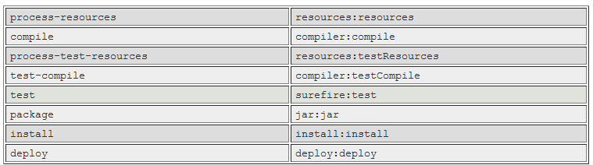
Intro to MAVEN
Build lifecycle

Slide 15
Backbase hosts a repository that provides a convenient mechanism to setup a local Maven development environment.
Backbase MAVEN Repository
https://repo.backbase.com/repo
Archetypes available from this repository:
Backbase Portal Archetype Blank
Launchpad Archetype

Slide 16
Jetty is lightweight HTTP server and servlet container
JETTY
maven-jetty-plugin
Run using command
mvn jetty:run
If you want your data to be reset to initial data then before
jetty:run first execute the command:
mvn clean mvn clean
install (blank archetype)
–P clean-db (launchpad archetype)

Slide 17
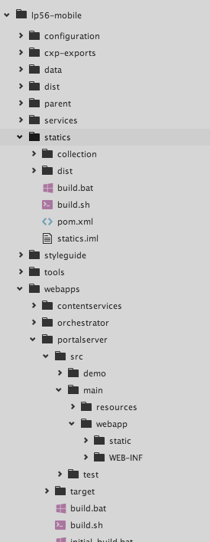
Archetype Project Structure
Highlights
webapps/ : Portal, CS & Orchestrator
configuration/ : all Backbase-specific configuration
services/ : custom Camel services
statics/ : Launchpad
collection & custom items
styleguide/ : documentation of Launchpad Components

Slide 18
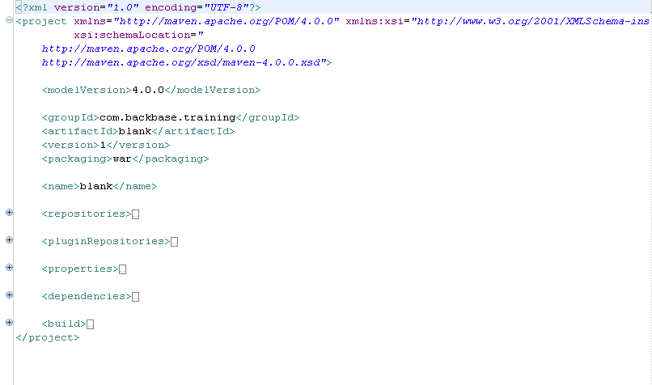
Project Object Model (POM)

Slide 19

Follow the “Getting Your First Launchpad-Based Portal Set Up” how to guide to create your own developer setup.
Exercise: Archetype Setup
https://my.backbase.com/resources/how-to-guides/ getting-your-first-launchpad-based-portal-set-up/

Slide 20

Archetype Structure
Portal Technologies

Slide 21
Configuration: /configuration
Directories
Source and test: /src/main, /src/test
Resources and config: /src/main/resources
Spring config: /src/main/resources/META-INF/spring
Portal import scripts: /src/main/resources/import
Java code: /src/main/java
Webapp code: /src/main/webapp
Static files: /src/main/webapp/static
WEB-INF: /src/main/webapp/WEB-INF
Maven build directory: /target

Slide 22
POM (Project Object Model): /pom.xml
Files
Dependencies
Build
Plugins
Jetty
Web app config: /src/main/webapp/WEB-INF/web.xml
Links to Spring config

Slide 23
Collections
Portal Technologies

Slide 24
About Collections
Collections are a convenient way of grouping custom items together (widgets, containers, templates, chromes, etc…).
A collection is simply a maven project, that you can add as a dependency of your portal. It can be developed, tested and deployed independently from your portal project. It can also be re-used in multiple projects.

Slide 25
Collection Contents
The contents of a collection is managed by Bower. At the root of each collection, you will find a bower.json file, listing the available items, for example:
{
"name": "my-custom-collection", "version": "0.1.0",
"private": true,
"dependencies": {
"chrome-templates": "^1.0.1",
"container-column": "^1.0.1",
"container-panel": "^1.0.1",
"container-tabs": "^1.0.1",
"page-launchpad-base": "^1.0.3",
"widget-device-dna": "^1.2.2",
"widget-login": "^2.2.3",
"widget-navbar": "^3.0.1",
"widget-widgets-catalog": "^1.1.2", "template-launchpad-page": "^1.0.1"
}
}

Slide 26
Points To Remember
Portal uses a core set of
technologies,
but can integrate with many more
Maven is a convenient way to run a local Portal development environment

Slide 27
Thank you!
www.backbase.com
sales-eu@backbase.com
New York: +1 646 478 7538
Amsterdam: +31 20 465 8888
32

